Slide 1
Static Routing
UIU CISCO Networking Academy
Routing Protocols
CSE 324
FaceBook Group: www.facebook.com/groups/CN324
Notes:
Cisco Networking Academy program
Routing Protocols
Chapter 6: Static Routing

Slide 2
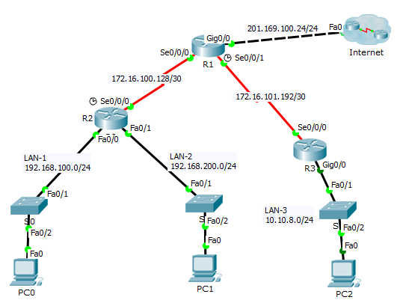
Routing Protocols
Notes:
Chapter 6

Slide 3
Routing Protocols
A routing protocol specifies how routers communicate with each other, disseminating information that enables them to select routes between any two nodes on a computer network.
Routing algorithms determine the specific choice of route.
Each router has a priori knowledge only of networks attached to it directly.
Notes:
Chapter 6

Slide 4
Routing Protocols
Routing
Static Routing
Static Routing
Default Routing
Dynamic Routing
Notes:
Chapter 6

Slide 5
Static Routing Why Use Static Routing?
Static routing provides some advantages :
Static routes are not advertised over the network, resulting in better security.
Static routes use less bandwidth than dynamic routing protocols, no CPU cycles are used to calculate and communicate routes.
The path a static route uses to send data is known.
Notes:
6.1.1.2

Slide 6
Static Routing Why Use Static Routing? (continued)
Static routing has the following disadvantages:
Initial configuration and maintenance is time-consuming.
Configuration is error-prone, especially in large networks.
Administrator intervention is required to maintain changing route information.
Does.
Requires complete knowledgnot scale well with growing networks; maintenance becomes cumbersomee of the whole network for proper implementation.
Notes:
6.1.1.2

Slide 7
Static Routing When to Use Static Routes
Static routing has three primary uses:
Providing ease of routing table maintenance in smaller networks that are not expected to grow significantly.
Routing to and from stub networks. A stub network is a network accessed by a single route, and the router has no other neighbors.
Using a single default route to represent a path to any network that does not have a more specific match with another route in the routing table. Default routes are used to send traffic to any destination beyond the next upstream router.
Notes:
6.1.1.3

Slide 8
Types of Static Routes Static Route Applications
Static Routes are often used to:
Connect to a specific network
Provide a Gateway of Last Resort for a stub network
Reduce the number of routes advertised by summarizing several contiguous networks as one static route
Create a backup route in case a primary route link fails
Notes:
6.1.2.1

Slide 9
Static Routes Configuration
Syntax: ip route [Dest_Net_Address] [Net_Mask] [Exit_Interface/ Next Hoop]
Notes:
6.1.2.2

Slide 10
Types of Static Routes Default Static Route
A default static route is a route that matches all packets.
A default route identifies the gateway IP address to which the router sends all IP packets that it does not have a learned or static route.
A default static route is simply a static route with 0.0.0.0/0 as the destination IPv4 address.
Notes:
6.1.2.3

Slide 11
Default Static Routes Configuration
Syntax: ip route 0.0.0.0 0.0.0.0 [Exit_Interface/ Next Hoop]
Notes:
6.1.2.2

Slide 12


